Slide 1


Design Specification
Lambert Air Management System
Authors: Josh Snider, Matthew Lavin and Andrew Daur
Professor: Dr. Elvis Foster
Class: CS440

Slide 2
Section 1 : System Overview
Further detailed in the previous two deliverables.

Slide 3

Problem
Flight traffic has more than doubled in the last two decades
Airport management is a highly dynamic job with strict requirements for efficiency
Limited number of runways, gates, and terminals must serve flight volume

Slide 4
Increase in flight traffic
Notes:
Here is the diagram provided by the World Bank. It illustrates the dramatic increase since 1995, putting higher demand on airports that can’t expand their infrastructure. Recent volatility means data is needed for business decisions, not just guesswork.

Slide 5
Solution
Flight Management System developed from scratch
Easy data entry and decision-making for staff, modern data output for customers
Proven software means deployment at any airport
Standard object-oriented language
MySQL/MariaDB for data storage
Information processing broken into subsystems
Port Information Subsystem
Airline & Aircraft Information Subsystem
Flight Information Subsystem
Produce multiple business benefits:
Modernized, integrated software solution streamlines all aspects of airport logistics
Increased throughput and efficiency increases airport, airline revenue
Communication between connected airports on a shared software platform.

Slide 6
Object Flow Diagram
Relational Database (MySQL)
Port Information Subsystem
Arrival/Departure Subsystem
Aircraft & Airline Subsystem
LAMS exemplifies a simple and effective flow of data.
Notes:
The flow of data within the FMS is simple: the system is divided into three subsystems, each of which are connected to the central relational database. Desynchronization of data is avoided by having all subsystems’ queries being done on a shared database, eliminating the need to synchronize between distributed systems.
This also goes for our topology chart.

Slide 7
Information Topology Chart
Flight Management System
Aircraft & Airline Subsystem
Airport
Aircraft
Aircraft Category
Airline
Terminal
Gate
Runway
Country
Port Information Subsystem
Arrival/Departure Subsystem
Flight Crew
Flight Crew
Flights
Flight Schedules
System Entities
Notes:
Once again you see the system divided into three subsystems. Port Information, Arrival/Departure, as well as Aircraft & Airline. It illustrates the separation of the entities within our database. Later we will cover the relationships between all of these and how they all interact.

Slide 8
Section 2 : Design Conventions

Slide 9
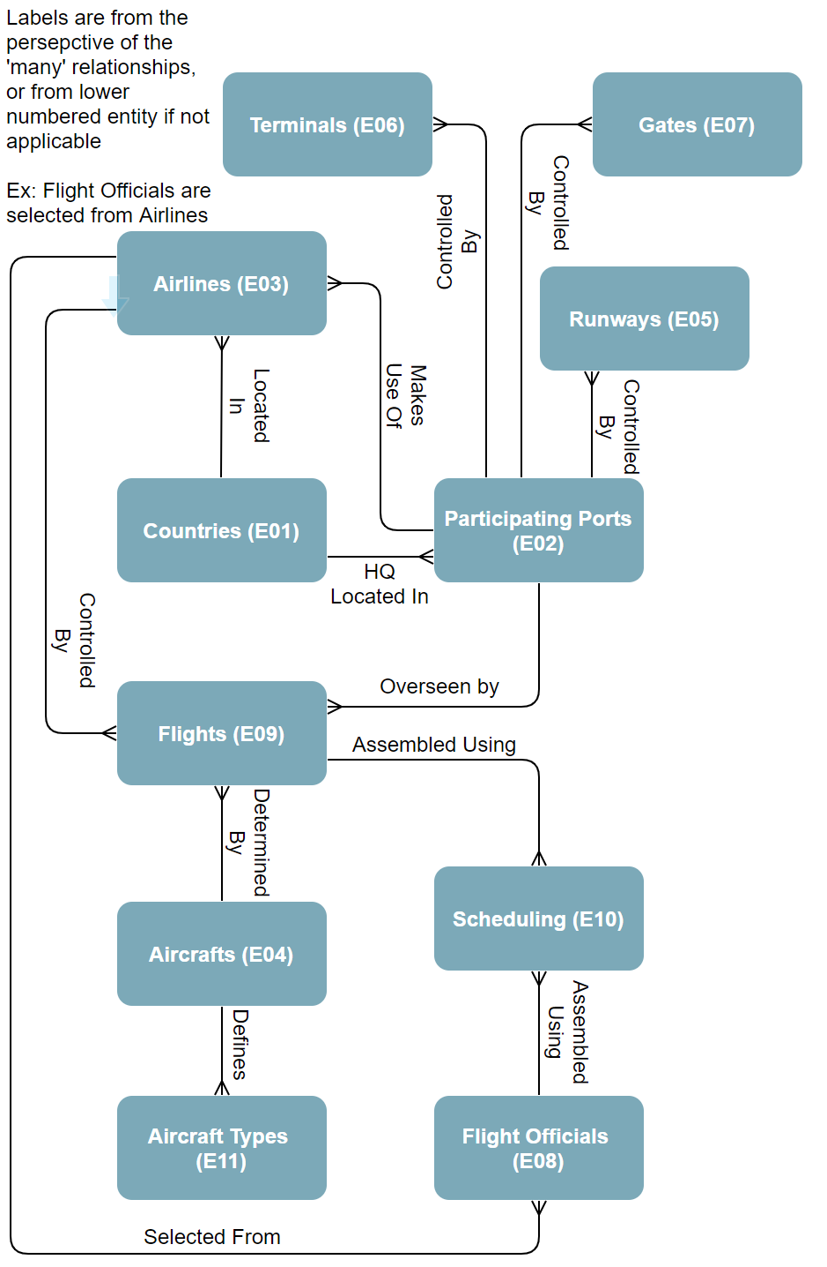
Entity Relationship Diagram (ERD)

Slide 10
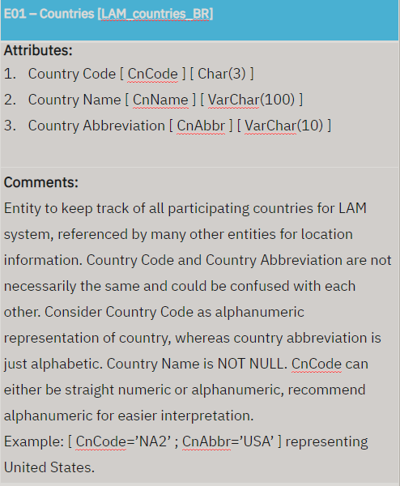
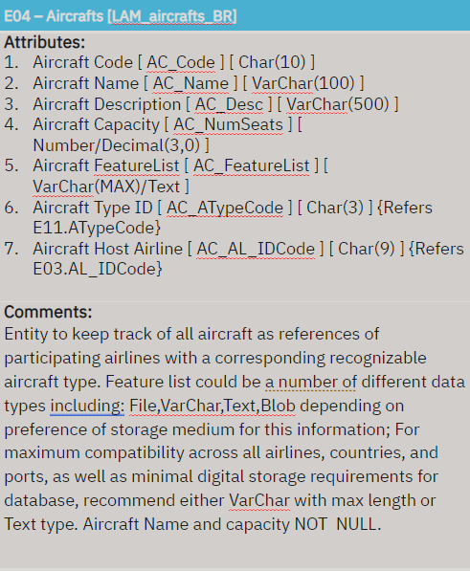
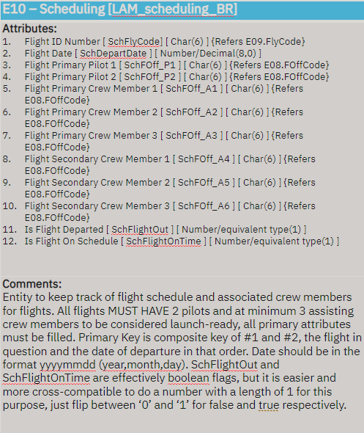
Entity Specification Grid (ESG) Samples
= Indexes
See Figure 3.2 in Document for full ESG detail

Slide 11
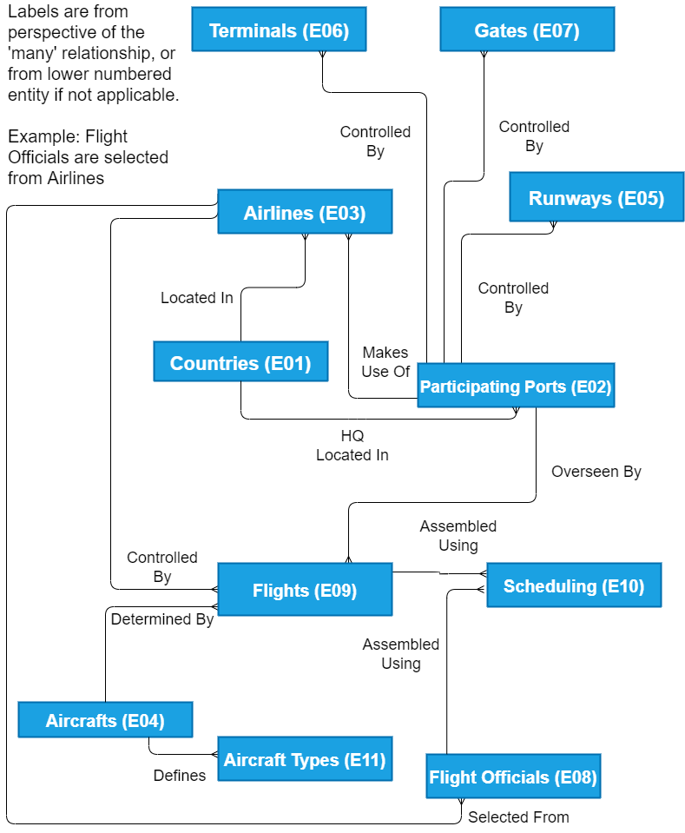
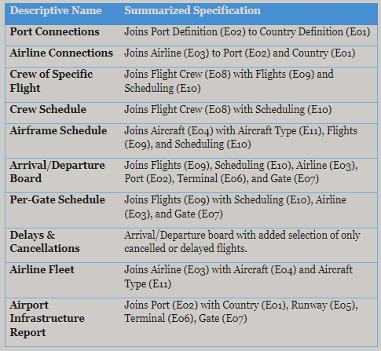
Section 3 : Database Specification
Logical Views Chart

Slide 12
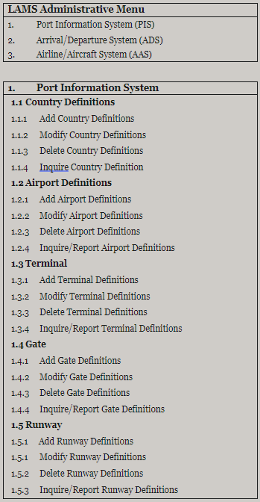
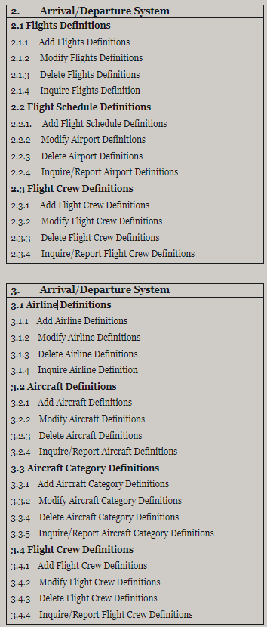
Section 4 – User Interface Design
User Interface Topology Chart (UITC) -->

Slide 13
Section 5 : Operations Design

Slide 14
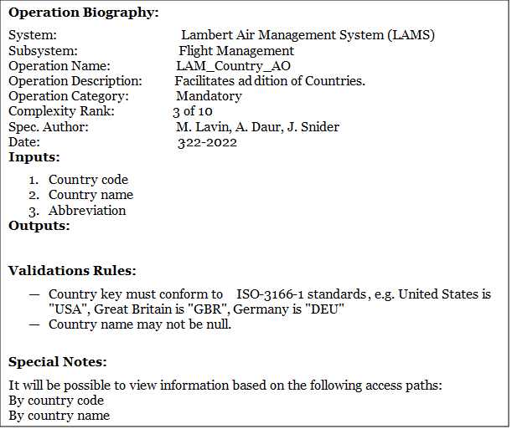
Country – ADD method
Operation Outline:
See Figure 5.1: ADD Method [Generic] Pseudo-code.

Slide 15
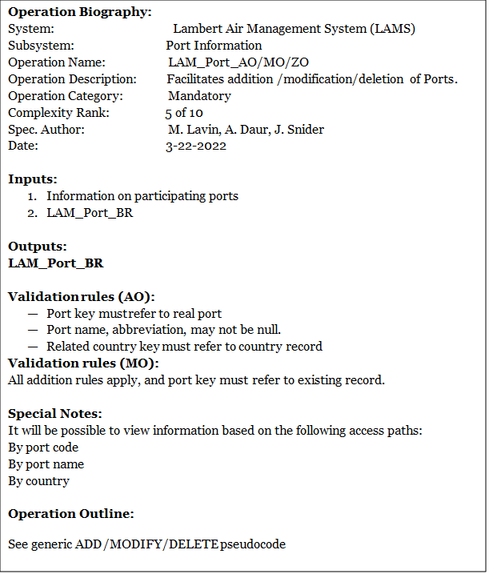
Port – ADD / MOD / DEL method
Operation Outline:
See Figure 5.1-5.3: ** Method [Generic] Pseudo-code.

Slide 16
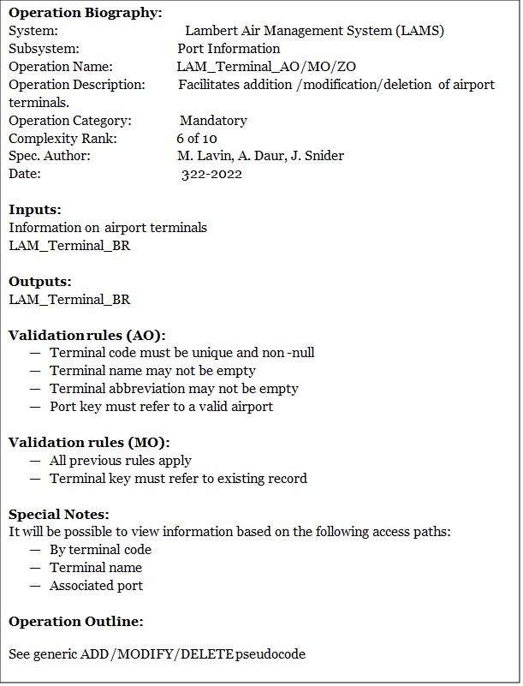
Terminal – ADD / MOD/ DEL method
Operation Outline:
See Figure 5.1-5.3: ** Method [Generic] Pseudo-code.

Slide 17
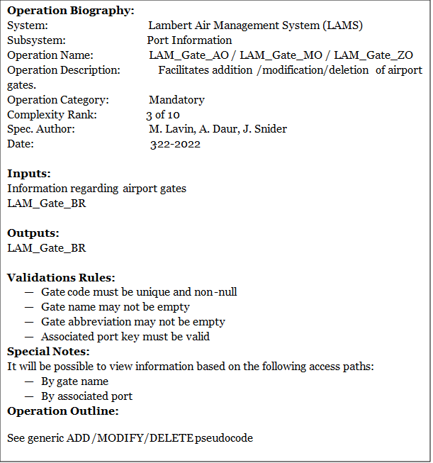
Gates – ADD / MOD / DEL method
Operation Outline:
See Figure 5.1-5.3: ** Method [Generic] Pseudo-code.

Slide 18
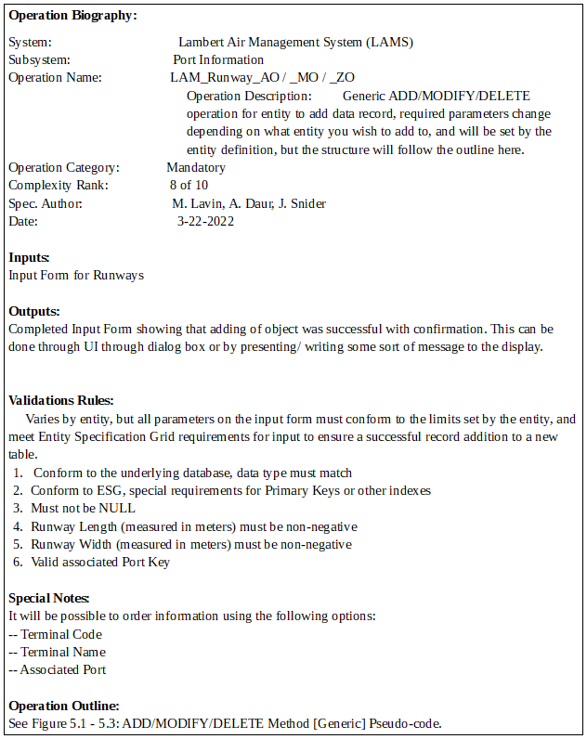
Runway – ADD / MOD/ DEL method
Input Form: 1. Runway Code
2. Runway Name
3. Runway Length
4. Runway Width
5. Host Port Code
Operation Outline:
See Figure 5.1-5.3: ** Method [Generic] Pseudo-code.

Slide 19
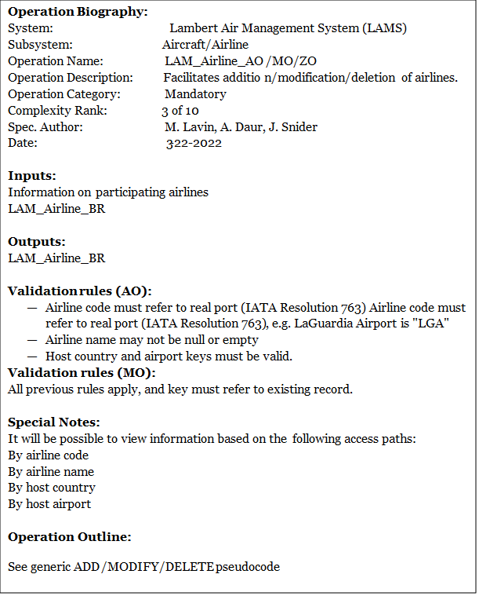
Airline – ADD / MOD / DEL method
Operation Outline:
See Figure 5.1-5.3: ** Method [Generic] Pseudo-code.

Slide 20
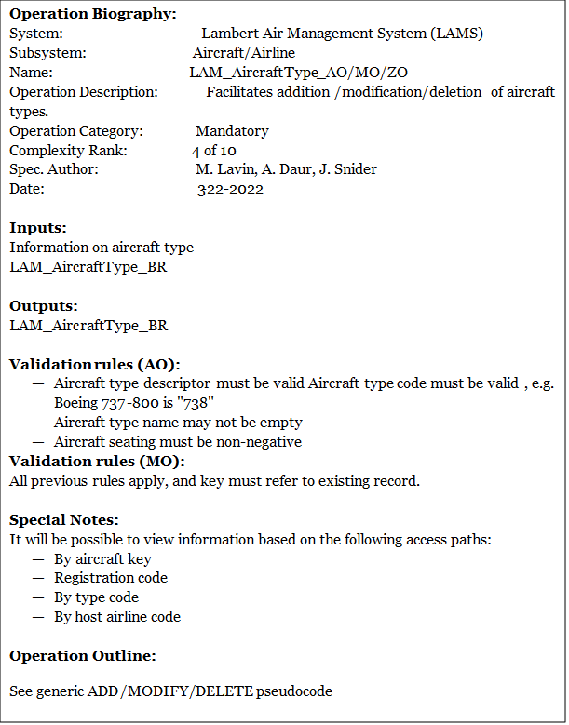
AircraftType – ADD / MOD / DEL method
Operation Outline:
See Figure 5.1-5.3: ** Method [Generic] Pseudo-code.

Slide 21
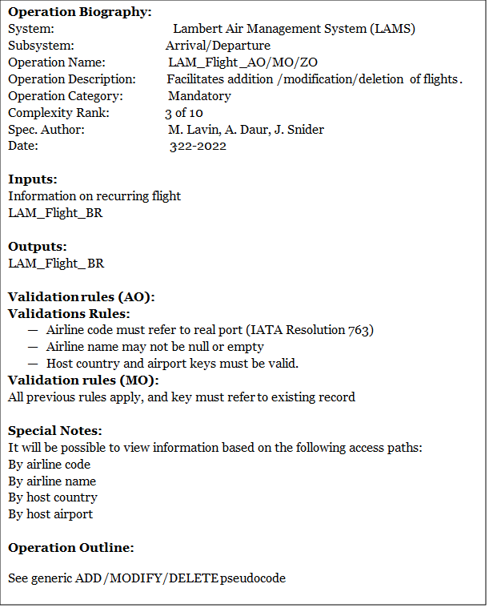
Flight – ADD / MOD / DEL method
Operation Outline:
See Figure 5.1-5.3: ** Method [Generic] Pseudo-code.

Slide 22
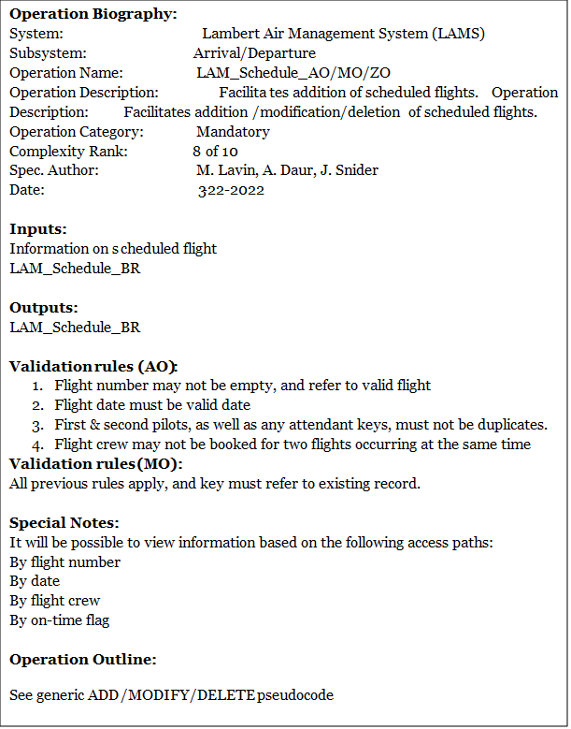
Schedule – ADD / MOD / DEL method
Operation Outline:
See Figure 5.1-5.3: ** Method [Generic] Pseudo-code.

Slide 23
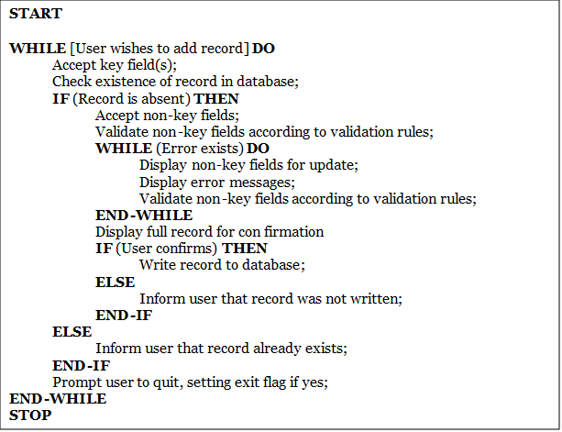
GENERIC – ADD method
Operation Biography: System: Lambert Air Management System (LAMS) Subsystem: Flight Management Operation Name: LAM_*ENTITY_NAME*_AO Operation Description: Generic ADD operation for entity to add data record, required parameters change depending on what entity you wish to add to, and will be set by the entity definition, but the structure will follow the outline here. Operation Category: Mandatory Complexity Rank: 8 of 10 Spec. Author: M. Lavin, A. Daur, J. Snider Date: 3-22-2022 Inputs: Input Form containing entry parameters that vary according to the entity you want to add to. Adding to Countries would involve ‘Country Name’ and ‘Country Abbreviated’ parameters, but if adding a Gate or Terminal would require different parameters suited to that entity. Indexing handled automatically. Outputs: Completed Input Form showing that adding of object was successful with confirmation. This can be done through UI through dialog box or by presenting/ writing some sort of message to the display. Validations Rules: Varies by entity, but all parameters on the input form must conform to the limits set by the entity, and meet Entity Specification Grid requirements for input to ensure a successful record addition to a new table. Conform to the underlying database, data type must match Conform to ESG, special requirements for Primary Keys or other indexes Must not be NULL Special Notes: None.
Operation Outline:

Slide 24
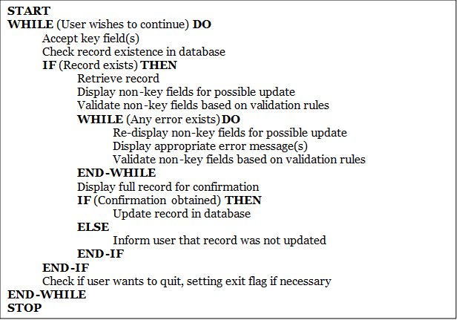
GENERIC – MOD method
Operation Biography: System: Lambert Air Management System (LAMS) Subsystem: Flight Management Operation Name: LAM_*ENTITY_NAME*_UO Operation Description: Generic UPDATE operation for entity, will edit any record in the entity with the user’s new entry, capable of updating Primary Key. Operation Category: Mandatory Complexity Rank: 8 of 10 Spec. Author: M. Lavin, A. Daur, J. Snider Date: 3-22-2022 Inputs: Input Form – same as generic add method PK_Index – Primary Key of record to update, so we know which record to fill with new information, ESG may require other restraints for this, unique to an entity. Input Form containing entry parameters that vary according to the entity you want to add to. Adding to Countries would involve ‘Country Name’ and ‘Country Abbreviated’ parameters, but if adding a Gate or Terminal would require different parameters suited to that entity. Outputs: Completed Input Form showing that adding of object was successful with confirmation. This can be done through UI through dialog box or by presenting/ writing some sort of message to the display. Validations Rules: PK_Index must be within bounds, if outside of bounds, use ADD method Conform to the underlying database, data type must match Conform to ESG, special requirements for Primary Keys or other indexes Must not be NULL Special Notes: None.
Operation Outline:

Slide 25
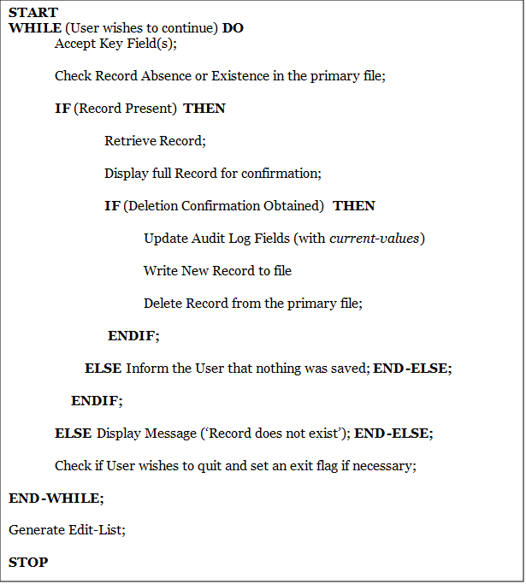
GENERIC – DEL method
Operation Biography: System: Lambert Air Management System (LAMS) Subsystem: Flight Management Operation Name: LAM_*ENTITY_NAME*_ZO Operation Description: Generic DELETE method for any record in the entity, removes data and does not recycle Primary Key if the item removed is not at the top of the stack. Operation Category: Mandatory Complexity Rank: 8 of 10 Spec. Author: M. Lavin, A. Daur, J. Snider Date: 3-22-2022 Inputs: PK_Index – Primary Key of record to update, so we know which record to fill with new information, ESG may require other restraints for this, unique to an entity. Outputs: Confirmation of an object deletion or removal via Dialog Box or printout to display. Show object information similarly to Generic ADD method for the record that was removed. Validations Rules: Must be a value to conforms to Database and ESG diagram Must be a value that is written onto already, cannot delete non-existent record Must not be NULL Special Notes: Recommend running generic inquire first for locating the record you want to delete, that way you have maximum searching capability without directly inserting Primary Key index.
Operation Outline:

Slide 26
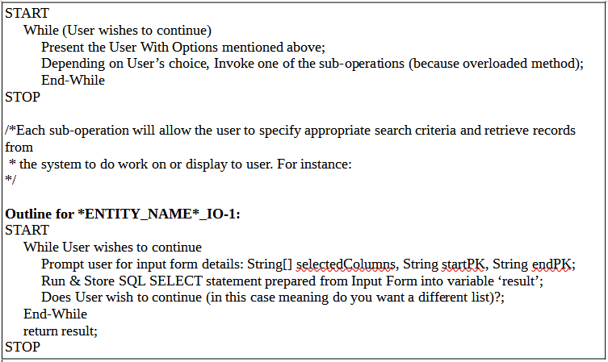
GENERIC – INQUIRE / REPORT method(s)
Operation Biography: System: Lambert Air Management System (LAMS) Subsystem: Flight Management Operation Name: LAM_*ENTITY_NAME*_IO / _RO Operation Description: Generic INQUIRE method for entity, allow common filtering parameters, and an optional String where user may enter an SQL ‘SELECT’ statement directly. Retrieves data from system. Operation Category: Mandatory Complexity Rank: 8 of 10 Spec. Author: M. Lavin, A. Daur, J. Snider Date: 3-22-2022 Inputs: sub_routine option – Number to indicate which of the sub-routine methods should be run to give user the appropriate input prompt. Input Form – Consists of columns or properties of the entity you want to search for, how you will search for them (sub-routine option), and what filtering should be applied. How you search, can consist of Primary Key Index (PK_Index) range or a combination of other indexes registered in the ESG for the desired entity that could be used to locate a record in a more user friendly way. Example in special notes. **filters – optional to refine the search (give me records like “property LIKE some_value”) Outputs: Returns Array of results (or some object that can hold multiple data types filled by database) Validations Rules: Input Form Must not be NULL (opt 1 or 2 must be chosen) If filters are applied they must be verified as valid SQL statement snippet (remember filters go at the end) Special Notes: It will be possible to query information with two possible main methods after detailing what columns or properties in the entity you would like to search for: 1. Directly give Primary Key index starting number and ending number (range) 2. Provide other indexes to look for, use combination of indexes for better results Example: I have a record in some entity with PK_ID=10 FNAME=”Ben” LNAME=”Steward” that I want to INQUIRE on, here are two different ways to call it. LAM_*ENTITY_NAME*_IO(int mode) where mode can be any integer that matches a valid sub-routine. Then a menu will be pulled up for user to input the information for the variables mentioned below, that then get passed to the sub routine. INQUIRE_1(selectedColumns[],startPK,endPK) or INQUIRE_2(selectedColumns[],“COLUMN_TO_MATCH”[],”VALUE_OF_COLUMN”[]) I could also pass SQL filters using this calling INQUIRE(selectedColumns[],startPK,endPK, true, **filters[]) INQUIRE(selectedColumns[],“COLUMN_TO_MATCH”[],”VALUE_OF_COLUMN”[], **filters[])
Operation Outline:

Slide 27
Section 6: Other Design Considerations
Physical USB & paper copy on first sign up, with user identification that we check prior to send out to ensure no duplicate copies
Digital .PDF file available on website at any time to replace missing copies
Help Message Spec -->
Notes:
All our system documentation will be provided as a digital .PDF file, physical USB and paper copy will be provided after inquiry about the system as a new customer. We do not replace these but the .PDF file is always up at our website.
Benefits of this are low cost universal media for distribution to prospective clients, both physical and digital for a one time fee. Because we have to know the client’s address, full name, etc. for physical delivery this discourages pranking or spoofing for free USB drives. Users can replace or download additional/updated copies for free at our website that is already paid for and hosted, so no additional costs for .PDF document. We will also have the ability to email it at any time for any reason to any client.

Slide 28
Section 7 : Summary & Concluding Remarks
Future Updates/Add-Ons:
Inclusion of an Infrastructure Subsystem would bring the FMS closer towards being a fully integrated airport management system. Management of resources such as fuel supplies, terminal amenities, and fleet vehicles would offer productivity increases and streamline identification of problems.
Notes:
This design specification has outlined the blueprint for a Flight Management System that will be robust and adaptable for any organization. It includes the following:
An overview of the system, including the problem definition, proposed solution, and some basic system architecture diagrams. The overview includes an Information Topology Chart (ITC) which helps us identify the key information entities in three comprehensive subsystems – the Port Information Subsystem (PIS), Arrival/Departure Subsystem (ADS), and the Airline/Aircraft Subsystem (AAD).
A database specification which includes both design and naming conventions, as well as an Entity Specification Grid (ESG) which covers all entities across each subsystem.
An operations specification which gives an entity operation specification (EOS) for each operation supported by the system.
A user interface specification which describes the interface through a User Interface Topology Chart (UITC).
A message specification which describes how system messages will be handled, as well as a help specification which describes the system of help messages which will be provided.

Slide 29
Project Schedule of Activities
Activity | Predecessor | Description | Estimated Time (days)
A | -- | Design System Architecture | 30
B | A | Design Operation Specifications | 12
C | B | Design Control Operations | 8
D | B | Design Modification Operations | 15
E | B | Design Inquiry/Report Operations | 7
F | C | Code Control Operations | 2
G | C | Prepare System User Guide | 5
H | F | Test Control Operations | 2
I | D | Code Modification Operations | 6
J | I | Test Modifications Operations | 4
K | H, J | Test Control/Modification Operations | 2
L | E | Code Report Operations | 3
M | L | Test Inquiry/Report Operations | 1
N | K, M, G | Integrations Test | 4
Notes:
Here we have the schedule of activities for the Lambert Air Management System. This table outlines the activities and their predecessors (Besides the initial activity A), as well as their estimated development time. It acts as a precursor to the Program Evaluation and Review Technique or PERT diagram

Slide 30
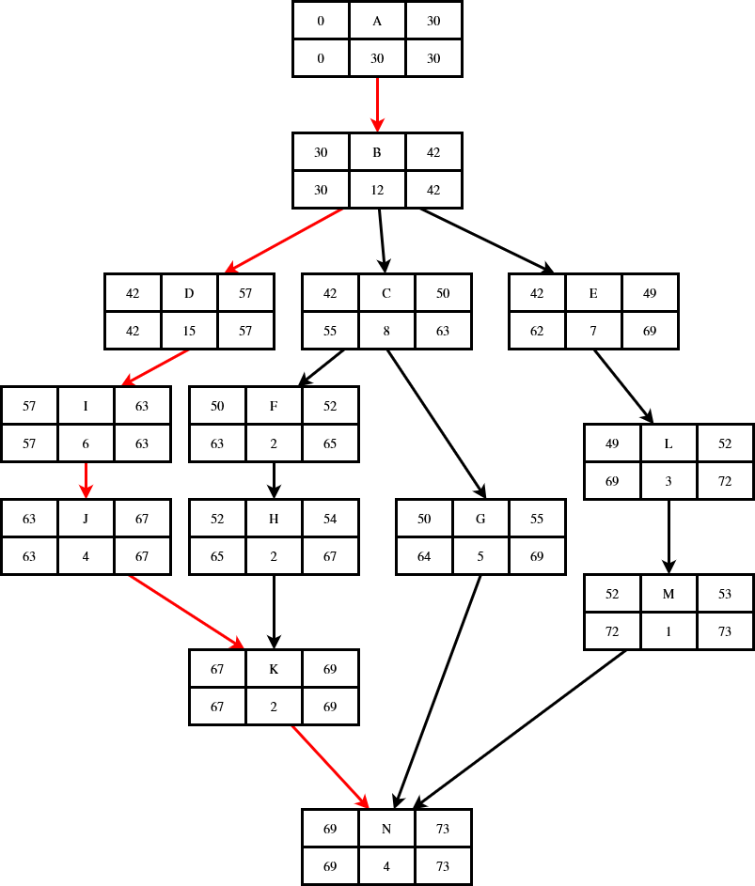
PERT Diagram
Quick reference for sequencing of tasks
Red path has no “slack” for delays
All others have allowance for delays, as long as latest start is met
Notes:
Here is our PERT diagram, which displays all project tasks within the overall sequence. Red arrows mark the critical path, the tasks which cannot be delayed without delaying the entire project. All other paths can tolerate some delay, as each task has some slack bet

Slide 31
Closing Remarks
This comprehensive design specification will serve as the definitive reference for our software implementation as we move forward into the development phase.
Each database entity is fully specified with its respective attributes, datatypes, indices, primary and foreign keys, and operations.
Each database operation (add, modify, delete, and inquire/report) has an accompanying specification, complete with procedure and data validation rules.
Complete documentation of the system before implementation informs both clients and developers on intended behavior and capabilities
Additional capabilities, such as expansion of airport management roles, will be done by revision of design spec before any system modifications occur

Slide 32
References
Foster, Elvis C. Software Engineering: A Methodical Approach. Second Edition. CRC Press. 2022
World Bank Group. “International Tourism, Number of Arrivals.” Data. Accessed March 3, 2022. https://data.worldbank.org/indicator/ST.INT.ARVL.

